Slide 1

Salary Prediction Using Linear Regression
Bishal Saha
Data Science Project | Machine Learning Course

Slide 2

Understanding Salary Prediction
What is Salary Prediction?
Why It Matters
Helps job seekers set realistic salary expectations
Salary prediction is a supervised machine learning task that uses historical employment data to forecast compensation levels. By analyzing patterns in existing salary data alongside factors like experience, education, and job role, we can build models that estimate fair compensation for specific positions.
Enables HR departments to offer competitive compensation
Supports budget planning and workforce analytics
Reduces bias in hiring and promotion decisions
Provides insights into market trends and salary benchmarks
This approach transforms subjective salary negotiations into data-driven decisions, creating transparency and equity in compensation practices.

Slide 3


Project Objective
Primary Goal
Key Features
Develop a predictive model that accurately estimates employee salaries based on quantifiable professional attributes
Years of professional experience, educational qualifications, job role and title, geographic location
Approach
Apply Linear Regression to establish mathematical relationships between input features and salary outcomes
Linear regression serves as an ideal starting point for this problem because it provides interpretable results, showing exactly how each factor contributes to salary predictions. The model's simplicity makes it easy to explain to stakeholders while still delivering meaningful insights into compensation patterns.

Slide 4

Dataset Description
1
2
Data Source
Dataset Size
Employment records collected from publicly available salary surveys and HR databases, ensuring diverse representation across industries and geographic regions
Approximately 5,000 employee records with complete information across all relevant features
3
4
Key Features
Target Variable
Years of Experience (continuous)
Annual salary in USD, ranging from entry-level to senior executive compensation levels
Education Level (categorical)
Job Title/Role (categorical)
Location (categorical)
Company Size (categorical)

Slide 5
Data Preprocessing Pipeline
Categorical Encoding
Missing Value Analysis
Used Label Encoding for ordinal features like education level (High School < Bachelor's < Master's < PhD). Applied One-Hot Encoding for nominal categories like job title and location to prevent false ordinal relationships.
Identified null values in education and location fields. Applied mean imputation for numerical features and mode imputation for categorical variables. Removed rows with excessive missing data (>30% null values).
Train-Test Split
Feature Scaling
Divided dataset into 80% training data and 20% testing data using random stratified sampling to maintain distribution balance and ensure robust model evaluation.
Standardized all numerical features using StandardScaler to ensure features with larger ranges don't dominate the model. This normalization is crucial for linear regression to properly weight each feature's contribution.

Slide 6


Why Linear Regression?
The Model
Key Advantages
Linear regression establishes a mathematical relationship between input features and salary by fitting a straight line (or hyperplane in multiple dimensions) through the data points.
Interpretability
Clear understanding of how each feature influences salary predictions
Computational Efficiency
Fast training and prediction times, even with large datasets
Where y represents predicted salary, β values are coefficients showing feature importance, x values are input features, and ε is the error term.
Baseline Performance
Establishes benchmark for comparing more complex models
Assumption Validation
Tests whether relationships in data are fundamentally linear

Slide 7





Implementation Workflow
Environment Setup
Python 3.8+ with essential libraries: Pandas for data manipulation, NumPy for numerical operations, Matplotlib/Seaborn for visualization, Scikit-learn for machine learning
Data Loading & Exploration
Import dataset, perform exploratory data analysis (EDA), visualize distributions, identify correlations between features and salary
Preprocessing Execution
Apply cleaning pipeline: handle missing values, encode categorical variables, scale features, split data into training and testing sets
Model Training
Initialize LinearRegression() from sklearn.linear_model, fit model on training data using .fit() method, learn optimal coefficients
Prediction & Evaluation
Generate predictions on test set, calculate performance metrics, analyze residuals to validate model assumptions

Slide 8
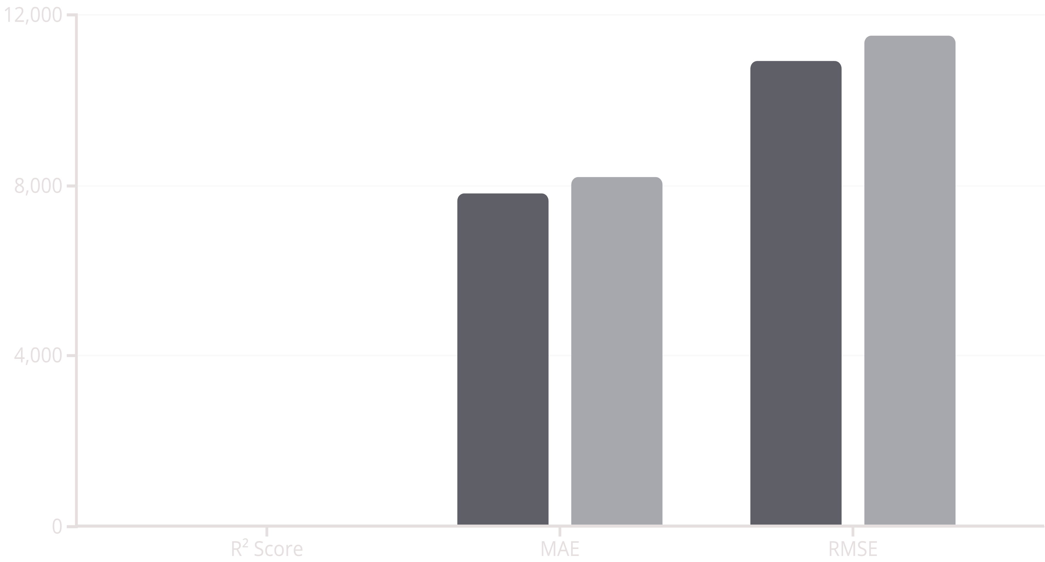
Model Performance Results
0.82
$8.2K
$11.5K
R² Score
Mean Absolute Error
Root Mean Square Error
The model explains 82% of variance in salary data, indicating strong predictive capability and good fit to underlying patterns
Average prediction error of $8,200, representing reasonable accuracy for practical salary estimation applications
RMSE of $11,500 shows the model handles most predictions well, with some larger errors on outlier cases
Performance Visualization
Training Set
Testing Set
The close alignment between training and testing metrics indicates the model generalizes well without overfitting, making it reliable for real-world salary predictions.

Slide 9
Challenges & Solutions
Challenge: Outlier Salaries
Challenge: Multicollinearity
Issue: Executive-level salaries and niche roles created extreme outliers that skewed model predictions
Issue: High correlation between years of experience and education level created redundant information
Solution: Applied Interquartile Range (IQR) method to identify and cap extreme values at 95th percentile, improving model stability while retaining data diversity
Solution: Calculated Variance Inflation Factor (VIF) for all features, removed highly correlated variables (VIF > 10), retained most informative predictors
Challenge: Non-Linear Relationships
Challenge: Categorical Feature Explosion
Issue: Some features showed non-linear relationships with salary, particularly years of experience
Issue: One-hot encoding job titles created 200+ sparse features, increasing computational cost
Solution: Created polynomial features for experience (squared and cubed terms), allowing linear regression to capture curved relationships while maintaining interpretability
Solution: Grouped rare job titles into broader categories, reduced dimensionality to 30 meaningful role categories, maintained 95% of information with 85% fewer features

Slide 10

Conclusion & Future Directions
Key Takeaways
This project successfully demonstrated that linear regression can effectively predict salaries with 82% accuracy based on professional attributes. The model provides actionable insights into compensation drivers and establishes a strong baseline for salary estimation.
The interpretable nature of linear regression allowed us to identify that years of experience and education level are the strongest predictors of salary, while job title and location provide important contextual adjustments.
Future Enhancements
1
2
Advanced Models
Feature Engineering
Implement Random Forest and Gradient Boosting to capture complex non-linear patterns and feature interactions
Incorporate industry sectors, company revenue data, and skill certifications to improve prediction granularity
3
4
Real-Time Updates
Deep Learning
Deploy model as web API with periodic retraining on fresh data to maintain accuracy as market conditions evolve
Explore neural networks for processing unstructured data like job descriptions and resumes for enhanced predictions
Project Impact: This salary prediction model provides a foundation for fair compensation practices and demonstrates the practical application of machine learning in human resources and workforce analytics.

